Slide 1
Collocations

Slide 2
What is a collocation?
Some words go along with some words in English.
These combinations just sound "right" to native English speakers, who use them all the time.

Slide 3
Look at these examples:
the fast train (correct)
… the quick train (X)
fast food (correct)
quick food (X)
a quick shower (correct)
…a fast shower (X)
a quick meal (correct)
…a fast meal (X)

Slide 4
Why learn collocations?
language will be more natural and more easily understood.
alternative and richer ways of expressing yourself.
Easier for our brains to remember and use language in chunks or blocks rather than as single words.

Slide 5
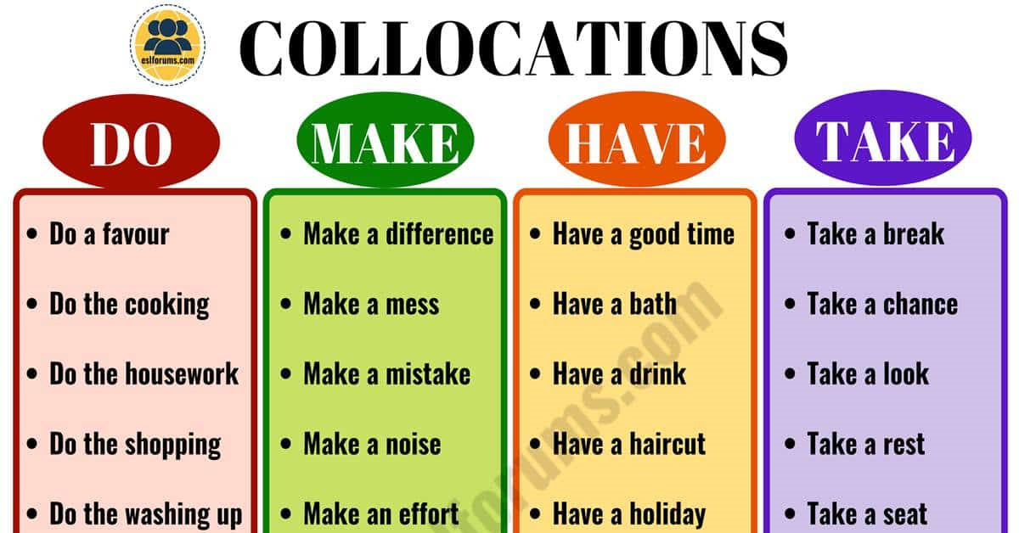

Slide 6
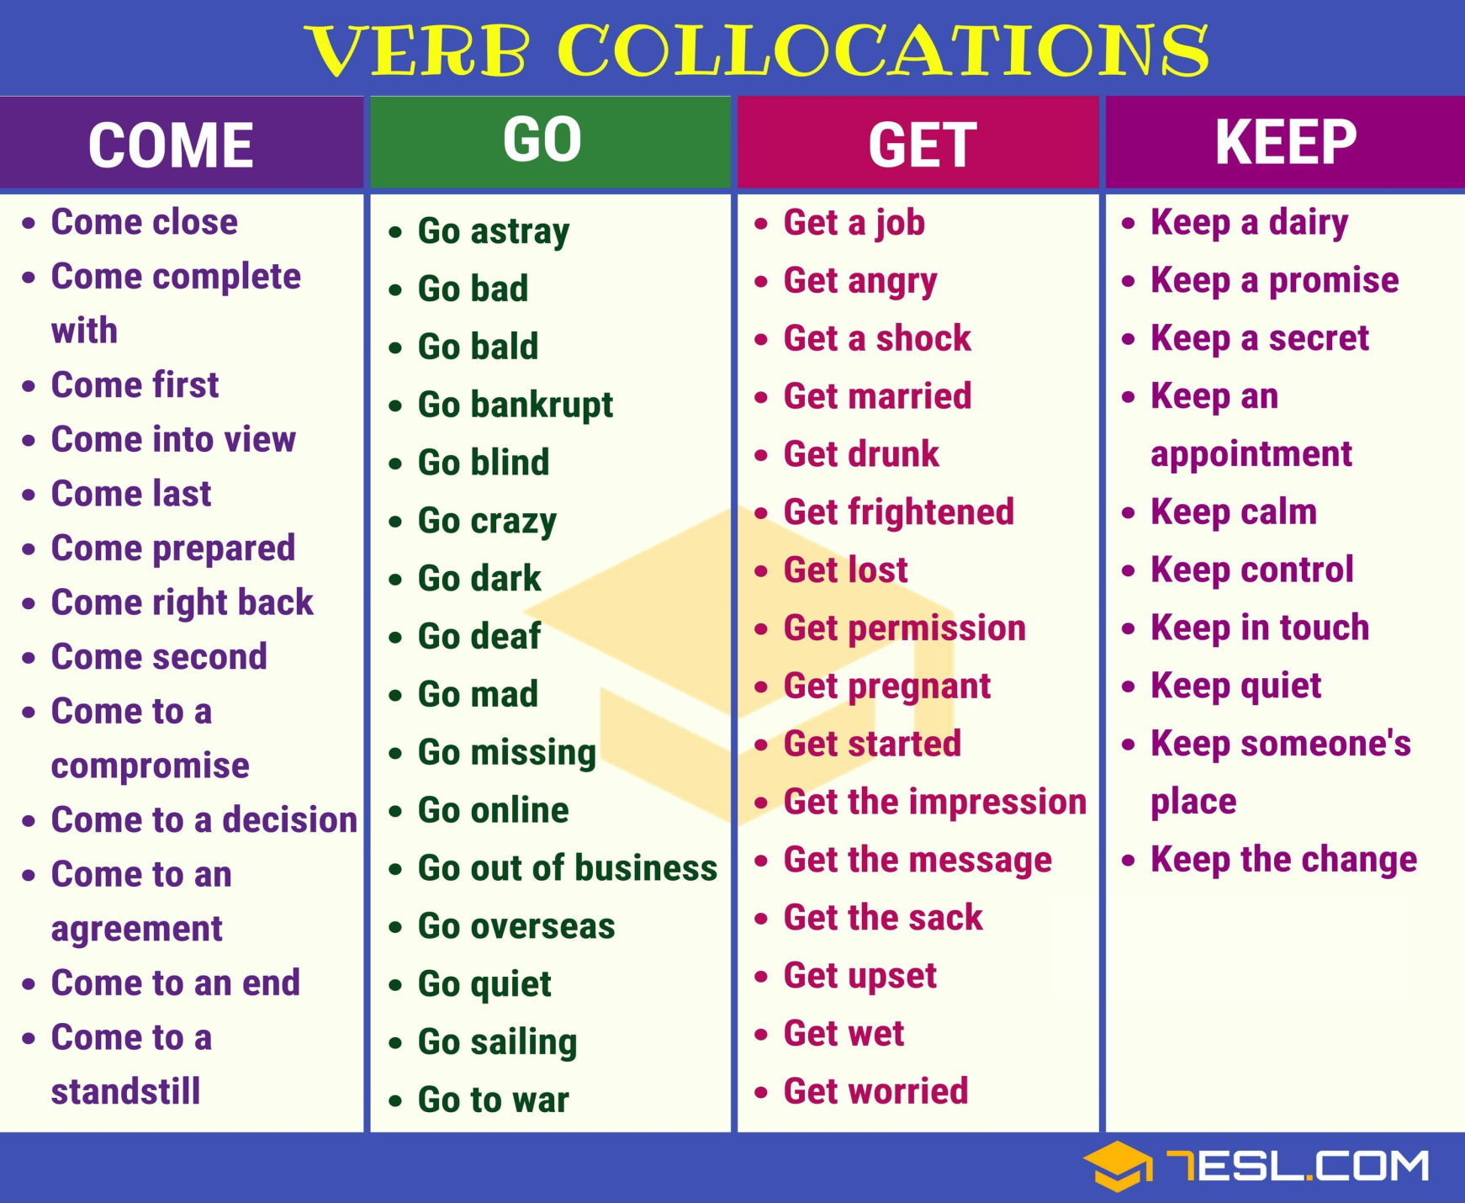

Slide 7
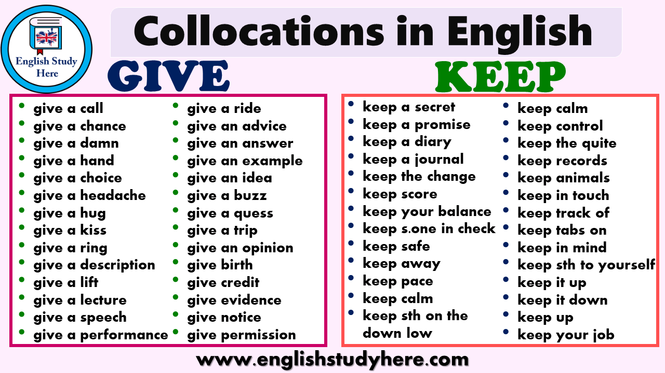

Slide 8
Exercise
1. My grandfather was a …………………. smoker, so few people were surprised when he died of oral cancer.
a) serial
b) heavy
c) big
2. She was a / an ……………………. wife who loved her husband more than anything else in the whole universe.
a) devoted
b) sincere
c) intelligent

Slide 9
3. I always avoid his company because he is a crashing ……………………..
a) bore
b) nuisance
c) guy
4. It is a golden ………………………… If you miss it, you will regret it.
a) chance
b) opportunity
c) offer

Slide 10
5. She seemed quite interested in buying that house, but at the last moment, she changed her …………………..
a) mind
b) thoughts
c) offer
6. Although I was …………………. annoyed by her attitude, I said nothing.
a) moderately
b) lightly
c) slightly

Slide 11
7. Could you …………………. the oil?
a) inspect
b) check
c) test

Slide 12
References
https://www.englishclub.com/vocabulary/collocations-common.htm
https://www.englishpractice.com/vocabulary/collocations-exercise-3/

